Slide 1
Climate Strategy & Corporate Carbon Footprints

Slide 2
Our climate strategy is to become climate neutral as a corporate by 2030 following science-based reduction targets
Business as usual
CORPORATE CARBON FOOTPRINT
Targeted emissions (avoid & reduce)
Greenhouse gas emissions
CLIMATE NEUTRAL CORPORATE
Offsetting remaining emissions
2020
2021
2022
2023
2024
2025
2026
2027
2028
2029
2030
Avoiding, reducing and offsetting greenhouse gases
Notes:
Climate strategy is rooted in cutting edge climate science
Our goal is to achieve climate neutrality by 2030 and we’re committed to net-zero no later than 2050.
Measuring starting point in 2020
Set science-based targets to avoid and reduce emissions
Offsett remaining (unavoidable) emissions in 2030 to become climate neutral

Slide 3
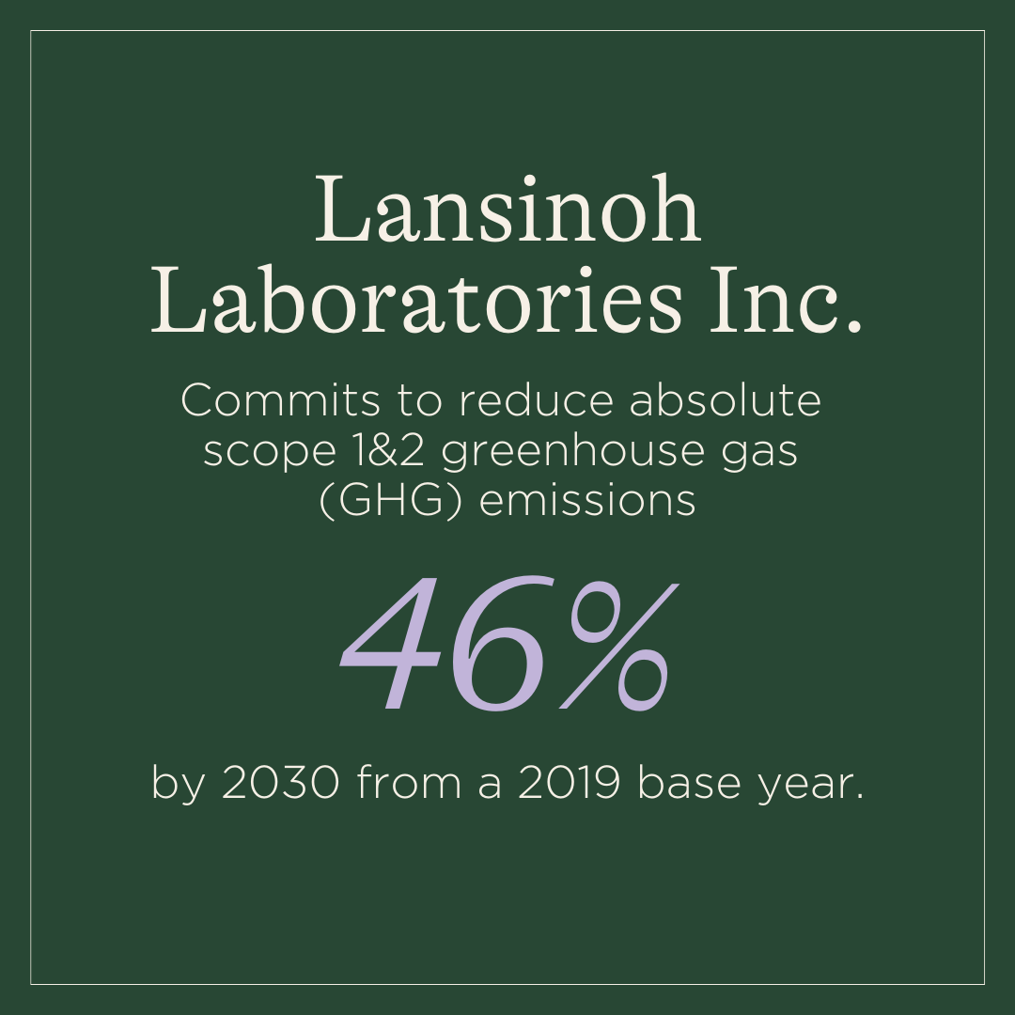
We‘re committed to the Science Based Targets Initiative

Slide 4
Corporate Carbon Footprint (tCO₂e)
Science-based targets
24,129
21,573
20,453
Scope 1 & 2 target overachieved
18,368
14,145
Nearly on plan for Scope 3 target
Notes:
2020
Scope 1 and 2 emissions
direct influence
already overachieved 2030 targets (maintain!)
Scope 3
Now account for 98%
Delivered emissions from supply chain with far less influence on
Increased due to more detailed reporting → emission higher than estimated in 2019 (raw materials, transport) + higher sales
Now targeting those developing several action plans

Slide 5
Corporate Carbon Footprint 2022
18,368t CO₂e

Slide 6
Corporate Carbon Footprint 2021
20,453t CO₂e

Slide 7
Corporate Carbon Footprint 2020
24,129t CO₂e

Slide 8
Corporate Carbon Footprint 2019
21,573t CO₂e

